Slide 1
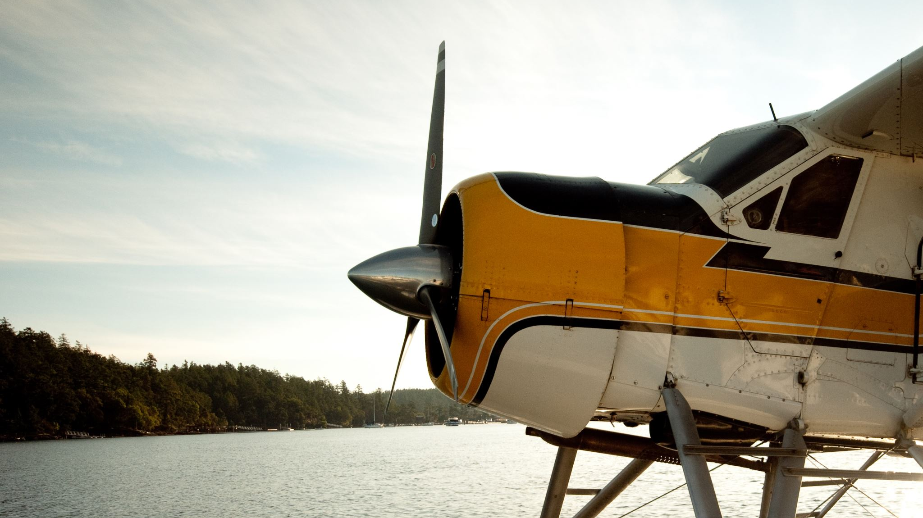
Image Processing Satellite Images for Contrails
George Mason University – DAEN 690
Team Error-Plane – Fall 2022
Notes:
Good Morning and welcome to Team Error-Plane's Fall 2022 Capstone project: Image Processing satellite images for contrails.

Slide 2
Meet the Team
Rob Mikula
Product Owner
Delaney Taubenberger
Developer
Pratibha Pandey
Scrum Master
Lorenzo Rollhauser Developer
Jon Tyler Developer
Team Error-Plane
Notes:
Before we begin, I would like to introduce our team, we are team error plane.

Slide 3
GMU Center of air transportation systems research (catsr)
Project Point of Contact
Dr. Lance Sherry (lsherry@gmu.edu)
Associate Professor in the Systems Engineering and Operations Research department in the College of Engineering and Computing at George Mason University
Director at Center for Air Transportation Systems Research at the College of Engineering and Computing at George Mason University
Supporting partners/mentors
Dr. Rajesh Aggarwal
Adjunct Professor in the MS Data Analytics Program at George Mason University
Notes:
Before we get into the project, we would like to thank our project sponsor, George Mason's CENTER OF AIR TRANSPORTATION SYSTEMS RESEARCH and our project point of contact Dr Lance sherry.
We would also like to thank dr rajesh aggarwal, our facility mentor for this project.

Slide 4
Table of contents
Project Background
What is contrail and the purpose of this project
Dataset and characteristics
High-level solution/approach
Sagemaker
Solution approach
Results
Hopper
Solution approach
Results
Pain points
Results
Visualizations
Findings
Summary
Summary of results
What did we discover
Potential future work
Notes:
This presentation will be broken down into 5 sections: background, our work in Amazon's Sage maker environment, GMU's Hopper environment, our results and lastly a summary of the project

Slide 5
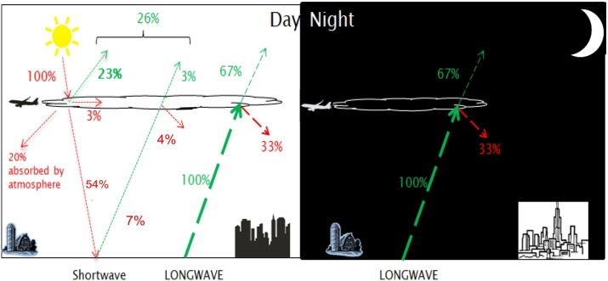
Problem Statement and Space
Contrail: Manmade cirrus clouds produced by aircrafts flying through super ice saturated regions
Reflect both short wave and long wave radiation
Aircraft effects on global heating
Solution
Use categorization ML methods to label images either "Yes" or "No" contrail
Goal is to identify images with contrails to make identification quicker and easier in future research ( human machine pairing) & provide evidence
Foundational paper trains individuals for a handful of hours and this takes out some guess work
Redirect air traffic to different locations or higher altitudes to reduce contrail production
Notes:
To begin, what is a contrail? a contrail or condensation trail is a man-made cloud that is created when an aircraft flies through an ice super saturated region and the aircrafts exhaust and water vapor freeze to create a cloud.
These clouds have a negative impact on the overall global heating. Using the graphic by Avila and others, contrails have an effect on both short wave radiation, which is heat from the sum, and long wave radiation which is the heat released by the earth that goes back into space. Contrails both reflect and absorb shortwave radiation which comes from the sun and is reflected back into space. Contrails also reflect longwave radiation back down onto the surface which is basically trapping heat that should be escaping into space. Both types if reflected radiation are a cause of the earth heating up. And is one of aircrafts major effects on global heating. The goal for this project is to use land satellite images and different machine learning methods to identify satellite images with contrails. For our research we used categorization machine learning methods to identify images if they contain a contrail. what we want to bring to this field of research is to make the human identification on contrails quicker and easier and to provide evidence of contrails before individuals have to label the images for further research.
The overall solution of this contrail research is to locate areas of high production and to redirect flights to reduce the production of the clouds.
D. Avila, L. Sherry, and T. Thompsom, "Reducing global warming by airline contrail avoidance: A case study of annual benefits for the contiguous United States," Transportation Research Interdisciplinary Perspectives, vol. 2, p. 100033, 2019.

Slide 6
Data architecture overview
Google Owned Data Set Collection
Split into Pos/Neg Folders
TIF to JPEG
Training & Testing Sets
Binary Classification Models
Try better models on larger set of data
Try models on test data
Notes:
This is a general overview of the process of the binary classification models that we performed on the landsat images. Each of the two environments that we worked on had slightly different processes, but this is the general flow of the project.
First the data was collected. The images are from land satellite and are stored by google and the bounding boxes were produced by teams at Google.
After the data has been collected, the data was split into known contrails and known no contrails based off of the bounding boxes identified by the teams at Google.
Since the satellite images are saved as tif files, which are large, they had to be converted to jpeg files to save space and the environments and algorithms we used only used jpeg
After the files were converted the images were split into training and testing sets.
The next step is to try different classification models on different types of filtered images, or bands. This was primarily completed in amazon sage maker.
Once we found a good combination of models and bands, larger training set was used to better the model
Lastly, once we tweaked the model and found good accuracy and precision balance, the test data was used.

Slide 7
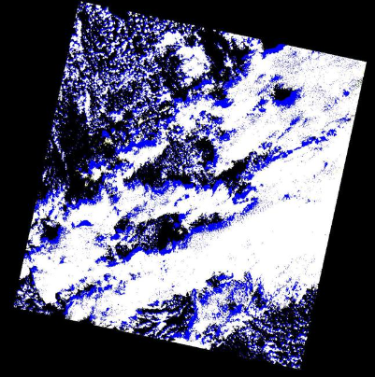
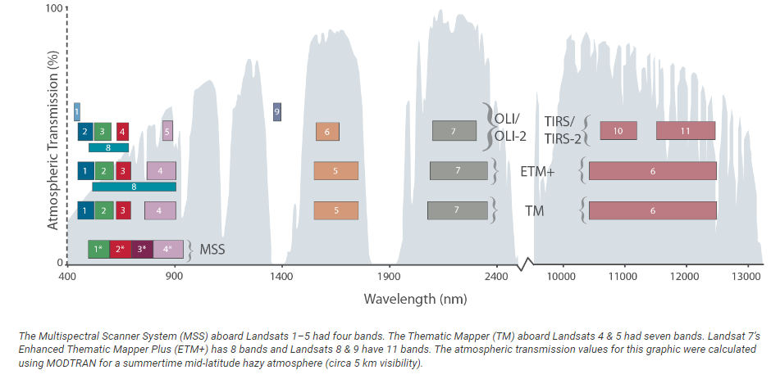
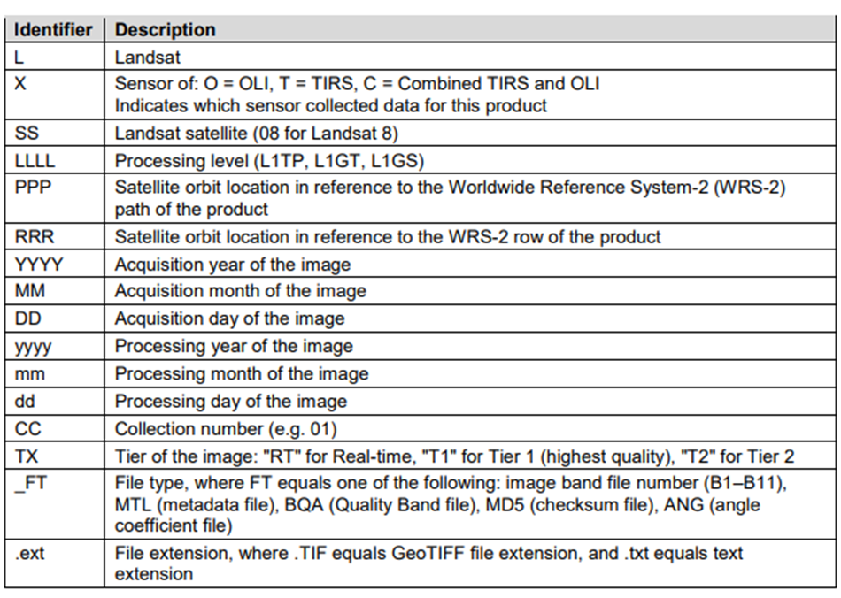
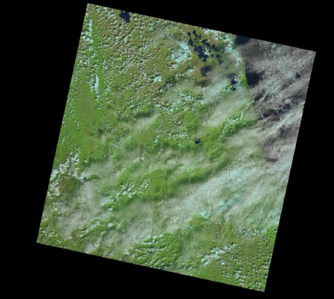
Dataset
Landsat Images from USGS National Land Imaging (1971 – present)
Each satellite image has up to 11 variations, one per band
Band is a filtered image by wavelength
Notes:
There are 2 parts of the dataset, the satellite images and the bounding boxes. For our research if there were bounding boxes recorded, then the image is positive for contrails.
The satellite images are from the Landsat satellite from the USGS National land imaging beginning in 1971 and is still being collected today.
The table in the screen is the naming convention of each of the tif image files.
What can be seen about the data set is that there are 11 different types of bands. Each band is filtered by different wavelengths and are aimed to collect data on different land masses or clouds.
The graphic is a visualization of the different bands at different wave lengths. The 2 images on the right are an example of the original image and one of the bands of the image.
I will now pass the presentation over to Rob to discuss our work with Amazon Sage Maker.
https://landsat.gsfc.nasa.gov/satellites/landsat-9/landsat-9-bands/
LC09_L1TP_026045_20211101_20220118_02_T1
https://earthexplorer.usgs.gov/scene/metadata/full/5e81f14f59432a27/LC90260452021305LGN01/

Slide 8
Motivation/Approach
To further investigation of the Contrails domain, our team decided to try a new approach using binary classification algorithms
Positive outcomes on this approach would include
Extending analysis techniques and algorithm families
Avoiding some of the subjectiveness from Contrail classification
Defers some of the challenges experienced by the Summer Capstone team
Aligning bounding boxes to source images of different sizes
Promotes new lines of inquiry potentially well-suited for commercial cloud (Sagemaker) or Hopper capabilities
Achievements demonstrate viability of the end-to-end, semi-automated analysis pipelines
Notes:
Voice track – The collaborations were very positive with the summer capstone, and we noted the challenges they faced in working with images of different size and trying to align bounding boxes accurately. By focusing on classification first, we could more quickly assess results using a variety of deep learning model families.

Slide 9
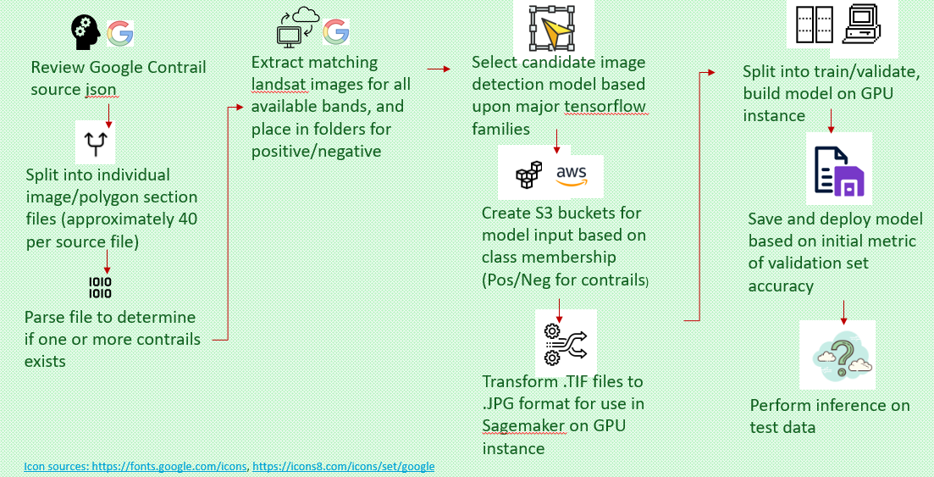
Sagemaker binary classification dataflow
AWS Managed Service for Machine Learning
Provides environments with pretrained models and supporting libraries (Tensorflow)
When combined with other AWS Service capabilities, end to end workflows can be efficiently assembled leveraging access to multiple neural network families and supporting GPU resources
Notes:
Voice track – Sagemaker, which integrates well with other AWS managed services. We took advantage of prebuilt environments but focused on implementations such as Tensorflow which we intend to be repeatable across different environments.
Noting the challenges with annotations, bounding box accuracy, this approach allows us to pull directly from the Google baseline data, leveraging working to identify existence of contrails.
Within Sagemaker, we were quickly able to survey several deep learning neural network choices including resnet, inception, efficientnet, and quickly assess higher and lower performing model families for this domain.
GPU access supported our efforts tremendously, both to transform source images into required format, but also to keep model generation steps to approximately 20 minutes or less, which helps as we worked with a first hundreds then multiple thousand images.

Slide 10
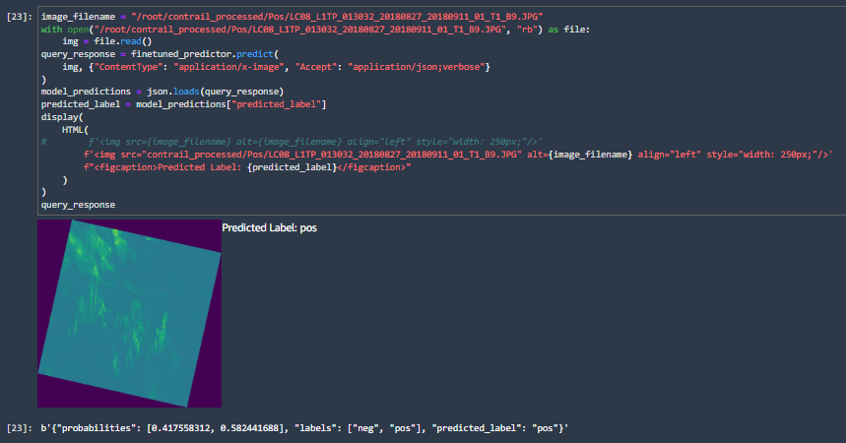
Sagemaker achievements
Measurable training performance improvement with more data
Compared multiple deep learning neural network families
Compared performance by the different types of imagery available (red channel, green channel, focused wavelength)
Modified hyperparameters, and saw improved performance up to 87% validation accuracy
The inference capability works very quickly for new images and provides confidence value to further assess model performance
Notes:
Voice track – The different types of imagery available helped us explore a hypothesis that selective presentation of color or wavelengths in the image may increase contrast, which helps with image detection.
The picture on the left is the inference capability which may be a very useful feature. We are able to use this to quickly verify the models against unseen data using a built-in predict method, which runs very quickly.

Slide 11
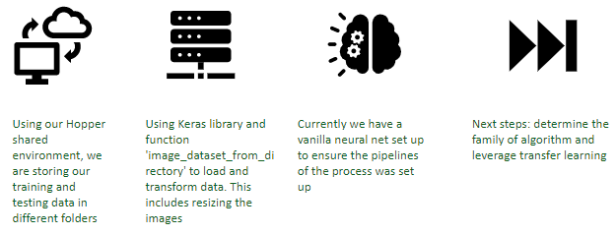

Notes:
Early issues prompted our team to make the effort to import the image files directly into a shared space on Hopper. Utilizing a shared single source of truth cuts down on potential confounding results and potential data leakage.
Environmental issues with Hopper arose when installing a major deep learning package, Keras. This has halted our team's progress until a solution can be found.

Slide 12
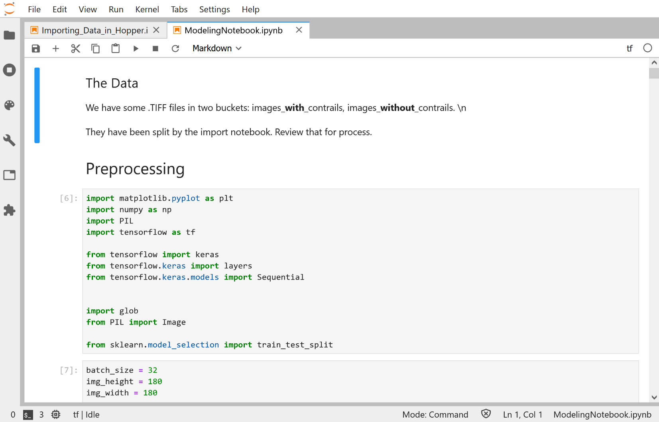
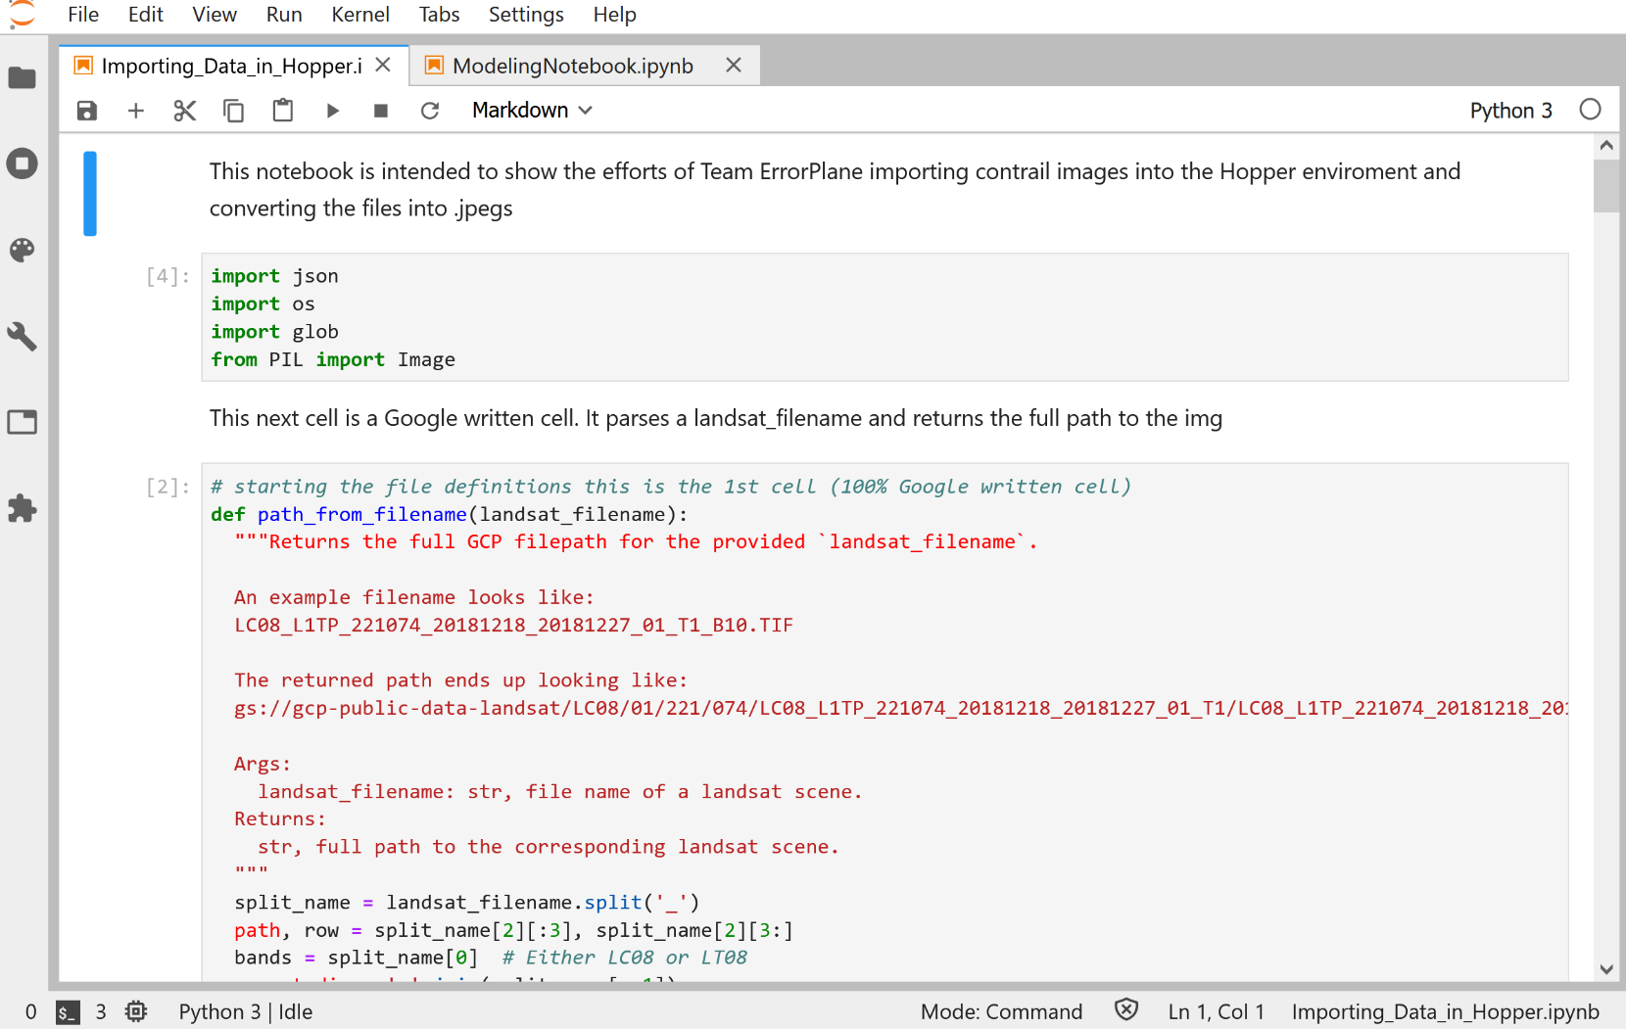
ORC’s Open OnDemand server provides access via a web interface to interactive applications such as JupyterLab.
Two notebooks are hosted on github and will set a sound foundation for future efforts.
Notes:
The Hopper Cluster is a batch computing resource available to all faculty and their students at George Mason University. JupyterLab is available as one of the interactive apps that can be launched directly from the Open OnDemand function of the Office of Research Computing. By having a familiar tool within the computing suite, our team was able to work jointly on this service. The Jupyter Notebook sessions are interactive and can be run for a maximum of 12 hours at a time. To run longer python jobs, you need to convert your code into a coherent python script that can then be submitted through SLURM.
Two Jupyter notebooks were created, one for importing data into Hopper and processing the image files to the correct format and the second for initial modeling purposes. Both notebooks can be seen on our GitHub repository.
Blockers
Issues on creating a shared environment across the team
Do we talk about the notebooks for the add here or somewhere else?
Shared environment resulted in different errors. Technical issues stuck this effort

Slide 13
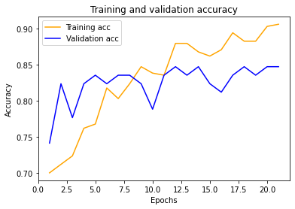
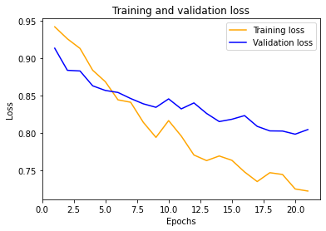
Training and validation

Slide 14
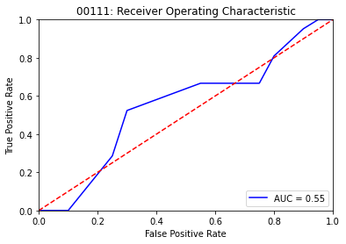

B3 ROC curve: 00111 and 00112
Note: B3 corresponds to green Landsat imagery

Slide 15
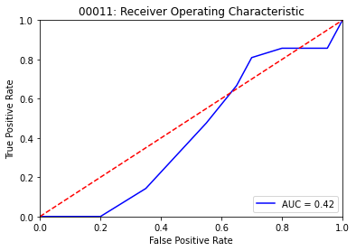
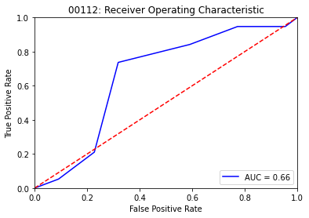
B4 ROC curve: 00111 and 00112
Note: B4 corresponds to green Landsat imagery

Slide 16
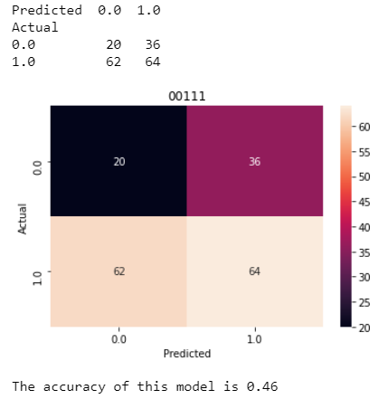
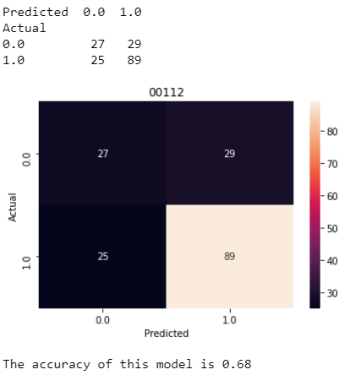
Overall performance: 00111 and 00112

Slide 17
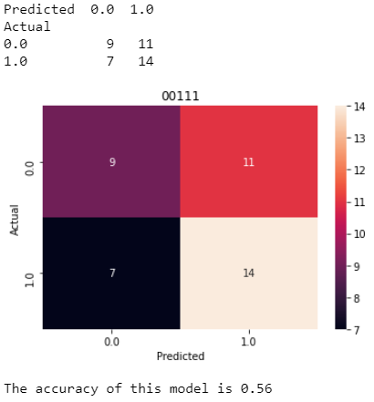
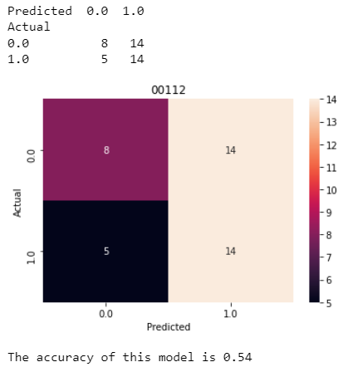
B3 Performance: 00111 AND 00112
Note: B3 corresponds to green Landsat imagery

Slide 18
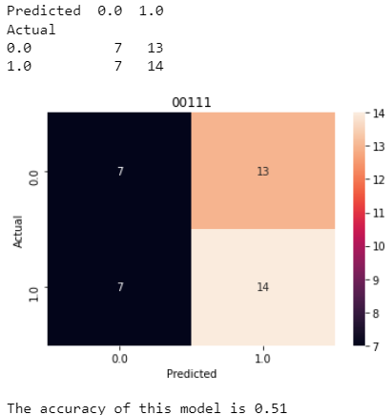
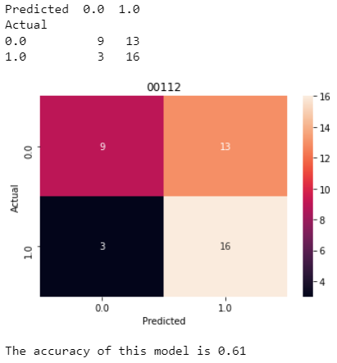
B4 PERFORMANCE: 00111 AND 00112
Note: B4 corresponds to green Landsat imagery

Slide 19
Summary of findings
Binary classification was a success!
Differentiate images as having the presence of contrails or no contrails
Performance by different types of imagery: red channel, green channel, blue channel and focused wavelength
~ 4% difference in accuracy noted, affirming potential that greater contrast in the underlying images may lead to better performance
70%-80% validation accuracy across experiments segmented by band and 56% accuracy in unseen data set shows promise
Modification of hyperparameters and associated improved performance in training and verification accuracy did not provide improvements in previously unseen test data
Mitigations and future work may involve testing on a full baseline with non-compressed images

Slide 20
Future work?
Team Error-Plane was successful in improving contrail detection accuracy, however, there is certainly a chance to further this effort in the future. Below are some ideas we are proposing:
Binary classification on non-compressed images
In Sagemaker, the images were transformed from .tif to .jpg/.png
Verification using Hopper
Localization within images in addition to the detection of contrails

